Slide 1
SHRI VISHNU ENGINEERING COLLEGE FOR WOMEN(A) IV B.TECH – II SEMESTER DEPARTMENT OF COMPUTER SCIENCE AND ENGINEERING C – 14 BATCH
Presented By : Guided by :
19B01A05F6 - PUPPALA VENKATA LAHARI Mr. G. RAMESH BABU
19B01A05G8 - TALUPULA ASWITHA
19B01A05H9 - VEGESNA NIKHITHA DEVI
19B01A05I8 - YADAVALLI SATYA VENKATA ANITHA

Slide 2
TITLE :
EMPLOYEE CHURN PREDICTION AND ANALYSIS
USING MACHINE LEARNING ALGORITHMS

Slide 3
Problem statement
Employee churn is a major concern for large companies as there is loss of valuable resource and extra resources like time and money has to be spent on recruiting new resources which directly affects their revenues.
Due to this, companies are seeking means to predict factors that influence employee churn.

Slide 4
ABSTRACT:
The main goal of our work is to develop a churn prediction model that assists employers in predicting which employees are most likely to be subject to churn.
Hence we are building a model that predicts the employee attrition based on certain attributes and their co-relation.
In this model, the techniques we used are flask, HTML, CSS, Machine Learning Algorithms.

Slide 5
EXISTING SYSTEM
Present churn predictors mainly focus on only customers but not on employees.
Most of the Existing systems use mainly logistic regression and KNN algorithms only.
current system uses around 20 parameters for prediction.
Low Accuracy

Slide 6
PROPOSED SYSTEM
Testing the data set with different classification and clustering algorithms.
Testing different data sets with different classification algorithms.
Comparing the results of different classification algorithms.

Slide 7
DOMAIN KNOWLEDGE
MACHINE LEARNING
PYTHON
JUPYTER NOTEBOOK

Slide 8
MACHINE LEARNING
Machine learning is known as training an algorithm to apply on different test data.
The main aim of machine learning algorithms is to train system and work automatically without human intervention.
The machine is trained by learning algorithm from training dataset and it generates a new model and this model tested with test dataset.
Once the model is generated then the model can e used for any test data without algorithm

Slide 9
PYTHON
Python offers all the skillsets that are required for a machine learning or AI project – stability, flexibility and a large number of tools. Python helps developers to be productive and confident about the product that they are manufacturing, from the stages of development to deployment and till the maintenance stage. These add to the popularity of the Python language.

Slide 10
JUPYTER NOTEBOOK
JupyterLab is the latest web-based interactive development environment for notebooks, code, and data. Its flexible interface allows users to configure and arrange workflows in data science, scientific computing, computational journalism, and machine learning. A modular design invites extensions to expand and enrich functionality

Slide 11
REQUIREMENT ANALYSIS
Software Requirements:
Python version above 3
Jupyter notebook
Libraries required
Pandas
TensorFlow
Scikit-learn
Matplotlib
Seaborn

Slide 12
HARDWARE REQUIREMENTS:
Operating system: windows 10 or above
Ram: 4GB
Hard disk: 32 GB
Architecture:x86 64-bit CPU (Intel / AMD architecture) for python
Memory and disk space required per user: 1GB RAM + 1GB of disk +. 5 CPU core.
Server overhead: 2-4GB or 10% system overhead (whatever is larger). 5 CPU cores.
Port requirements: Port 8000 plus 5 unique, random ports per notebook

Slide 13
Functional requirements :
The machine will predict the employee retainment in a company over a certain period of time.
Analyzing predicted result for accuracy.
Non - functional requirements :
Performance
Usability
Reliability
Accuracy
Maintainability

Slide 14
SYSTEM DESIGN:
USE CASE DIAGRAM
SEQUENCE DIAGRAM
BLOCK DIAGRAM
DATA FLOW DIAGRAM
ARCHITECTURE

Slide 15
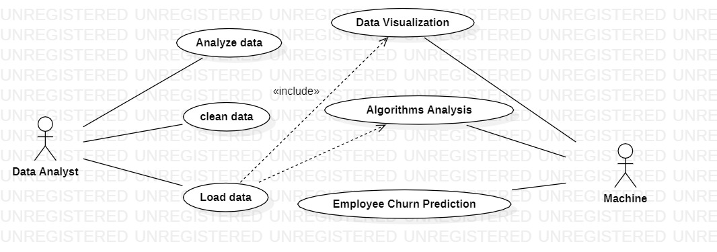
USE CASE DIAGRAM

Slide 16
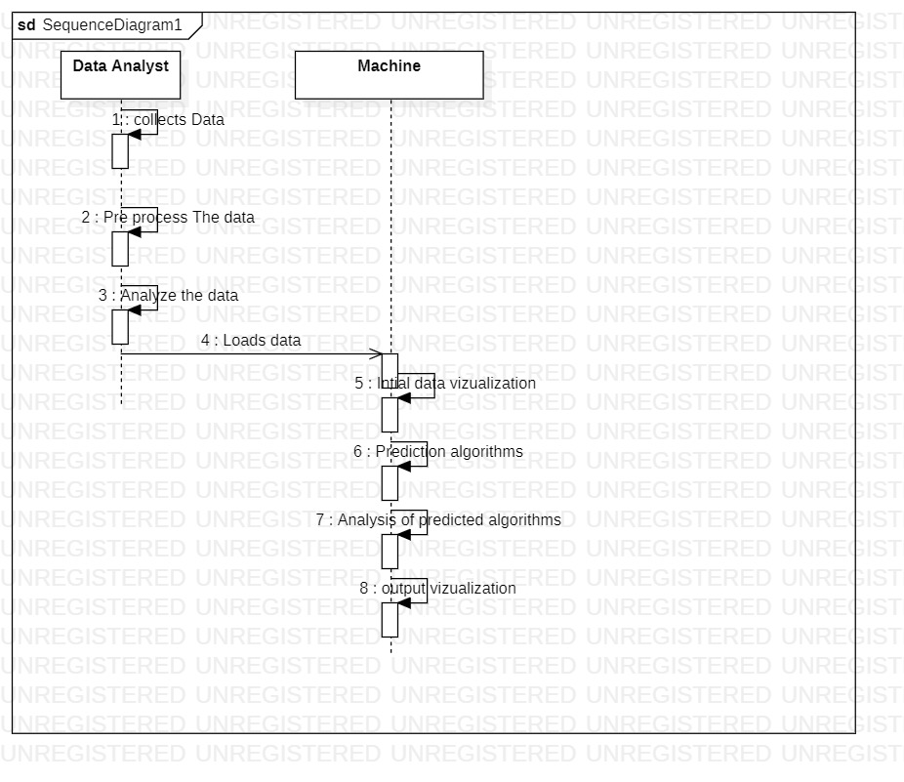
SEQUENCE DIAGRAM

Slide 17
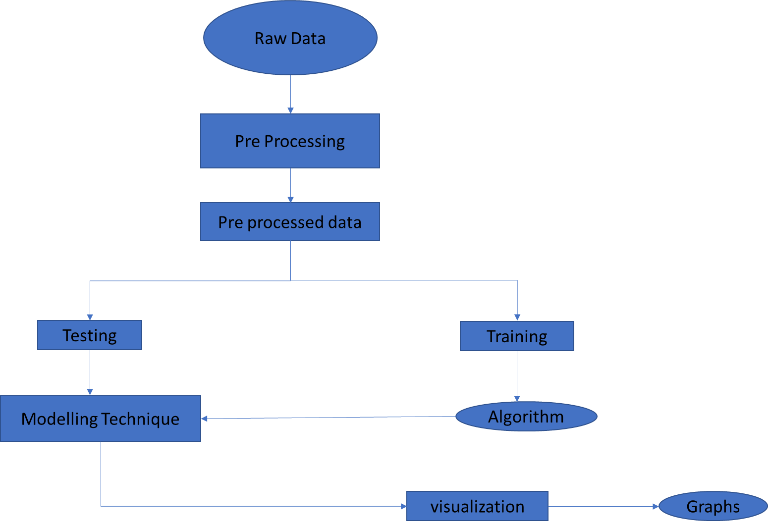
BLOCK DIAGRAM

Slide 18
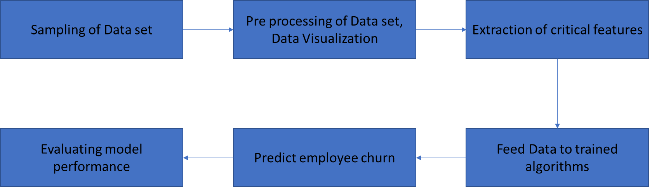
DATA FLOW DIAGRAM

Slide 19
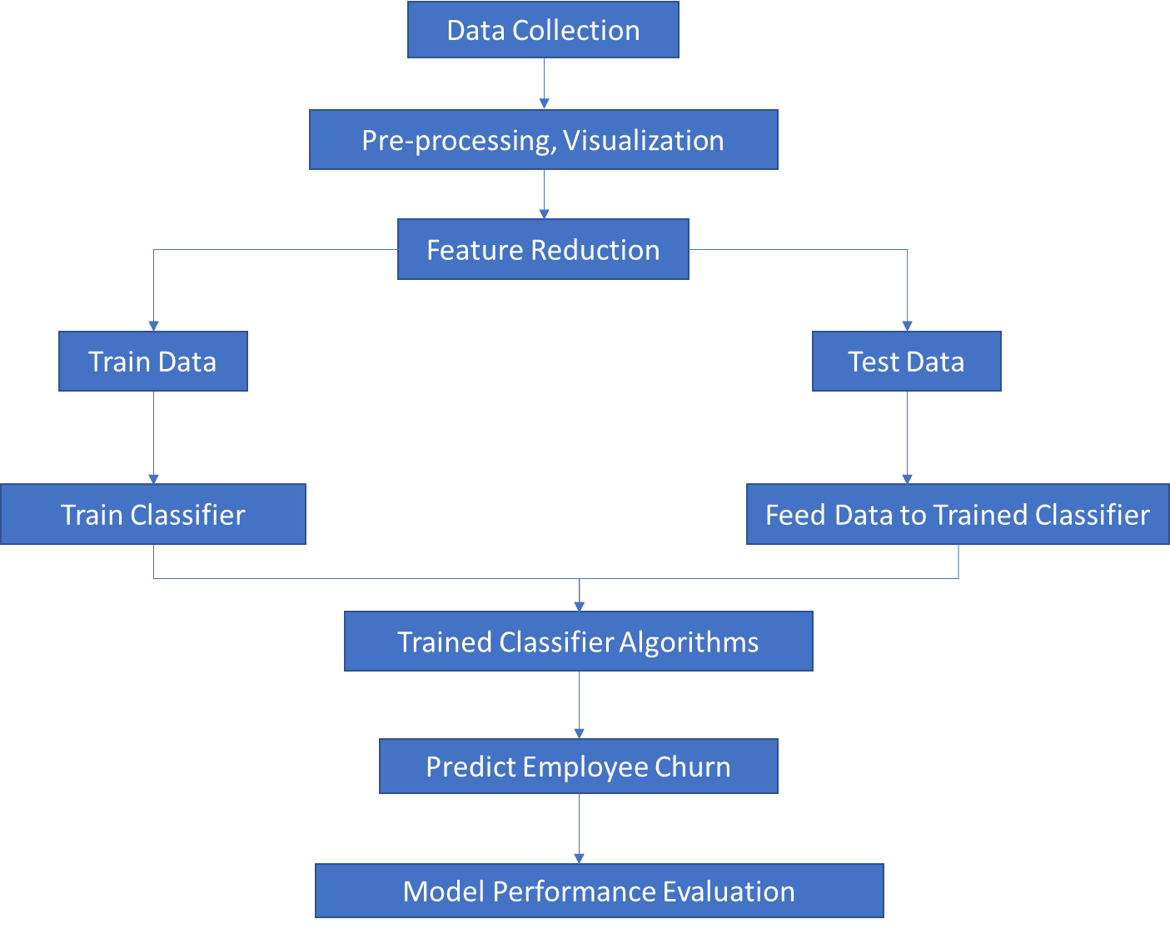
ARCHITECTURE

Slide 20
FUNCTIONALITIES / MODULES
Understanding a problem and final goal
Data collection
Data preparation and preprocessing
Modeling and testing
Model deployment and monitoring

Slide 21
Functional requirements :
The machine will predict the employee retainment in a company over a certain period of time.
Analyzing predicted result of different algorithms. They are:
LOGISTIC REGRESSION CLASSIFIER
RANDOM FOREST CLASSIFIER
BAGGING CLASSIFIER
KNN CLASSIFIER

Slide 22
TECHNICAL SKILLS:
1.Machine Learning
2.Python
3.Jupyter Notebook
4.Git Bash commands to open Jupyter notebook online

Slide 23
DESIGN COMPARISIONS:
EXISTING SYSTEM
PROPOSED SYSTEM
Present churn predictors mainly focus on only customers but not on employees.
Most of the Existing systems use mainly logistic regression algorithm only.
Current system uses around 20 parameters for prediction.
Low Accuracy
Analyzing different algorithms
Testing different data sets with different classification algorithms.
current system uses around 35 parameters for prediction
High Accuracy

Slide 24
SYSTEM DESIGN IMPROVEMENTS:
TASK #1: UNDERSTAND THE PROBLEM STATEMENT AND BUSINESS CASE
TASK #2: IMPORT LIBRARIES AND DATASETS
TASK #3: VISUALIZE DATASET

Slide 25
TASK #1: UNDERSTAND THE PROBLEM STATEMENT AND BUSINESS CASE
Hiring and retaining employees are extremely complex tasks that require capital, time and skills.
Small business owners spend 40% of their working hours on tasks that do not generate any income such as hiring.
Companies spend 15%-20% of the employee's salary to recruit a new candidate.
An average company loses anywhere between 1% and 2.5% of their total revenue on the time it takes to bring a new hire up to speed.
Hiring a new employee costs an average of $7645 (0-500 corporation).
It takes 52 days on average to fill a position.
The HR team collected extensive data on their employees that could help us predict which employees are more likely to quit.
The team provided you with an extensive data, here's a sample of the dataset:
Job Involvement
Education
Job Satisfaction
Performance Rating
Relationship Satisfaction
WorkLifeBalance

Slide 26
TASK #2: IMPORT LIBRARIES AND DATASETS
'Data Sets/Human_Resources.csv'
<class 'pandas.core.frame.DataFrame'>
RangeIndex: 1470 entries, 0 to 1469
Data columns (total 35 columns):
# Column Non-Null Count Dtype
--- ------ -------------- -----
0 Age 1470 non-null int64
1 Attrition 1470 non-null object
2 BusinessTravel 1470 non-null object
3 DailyRate 1470 non-null int64
4 Department 1470 non-null object
5 DistanceFromHome 1470 non-null int64
6 Education 1470 non-null int64
7 EducationField 1470 non-null object
8 EmployeeCount 1470 non-null int64
9 EmployeeNumber 1470 non-null int64
10 EnvironmentSatisfaction 1470 non-null int64
11 Gender 1470 non-null object
12 HourlyRate 1470 non-null int64
13 JobInvolvement 1470 non-null int64
14 JobLevel 1470 non-null int64
15 JobRole 1470 non-null object
16 JobSatisfaction 1470 non-null int64
memory usage: 402.1+ KB
17 MaritalStatus 1470 non-null object
18 MonthlyIncome 1470 non-null int64
19 MonthlyRate 1470 non-null int64
20 NumCompaniesWorked 1470 non-null int64
21 Over18 1470 non-null object
22 OverTime 1470 non-null object
23 PercentSalaryHike 1470 non-null int64
24 PerformanceRating 1470 non-null int64
25 RelationshipSatisfaction 1470 non-null int64
26 StandardHours 1470 non-null int64
27 StockOptionLevel 1470 non-null int64
28 TotalWorkingYears 1470 non-null int64
29 TrainingTimesLastYear 1470 non-null int64
30 WorkLifeBalance 1470 non-null int64
31 YearsAtCompany 1470 non-null int64
32 YearsInCurrentRole 1470 non-null int64
33 YearsSinceLastPromotion 1470 non-null int64
34 YearsWithCurrManager 1470 non-null int64
dtypes: int64(26), object(9)

Slide 27
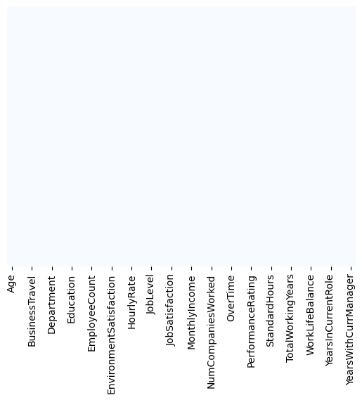
TASK #3: VISUALIZE DATASET
replace the 'Attritition' and 'overtime' column with integers before performing any visualizations
To check if there are any missing values. In the data taken there are no missing vaues

Slide 28
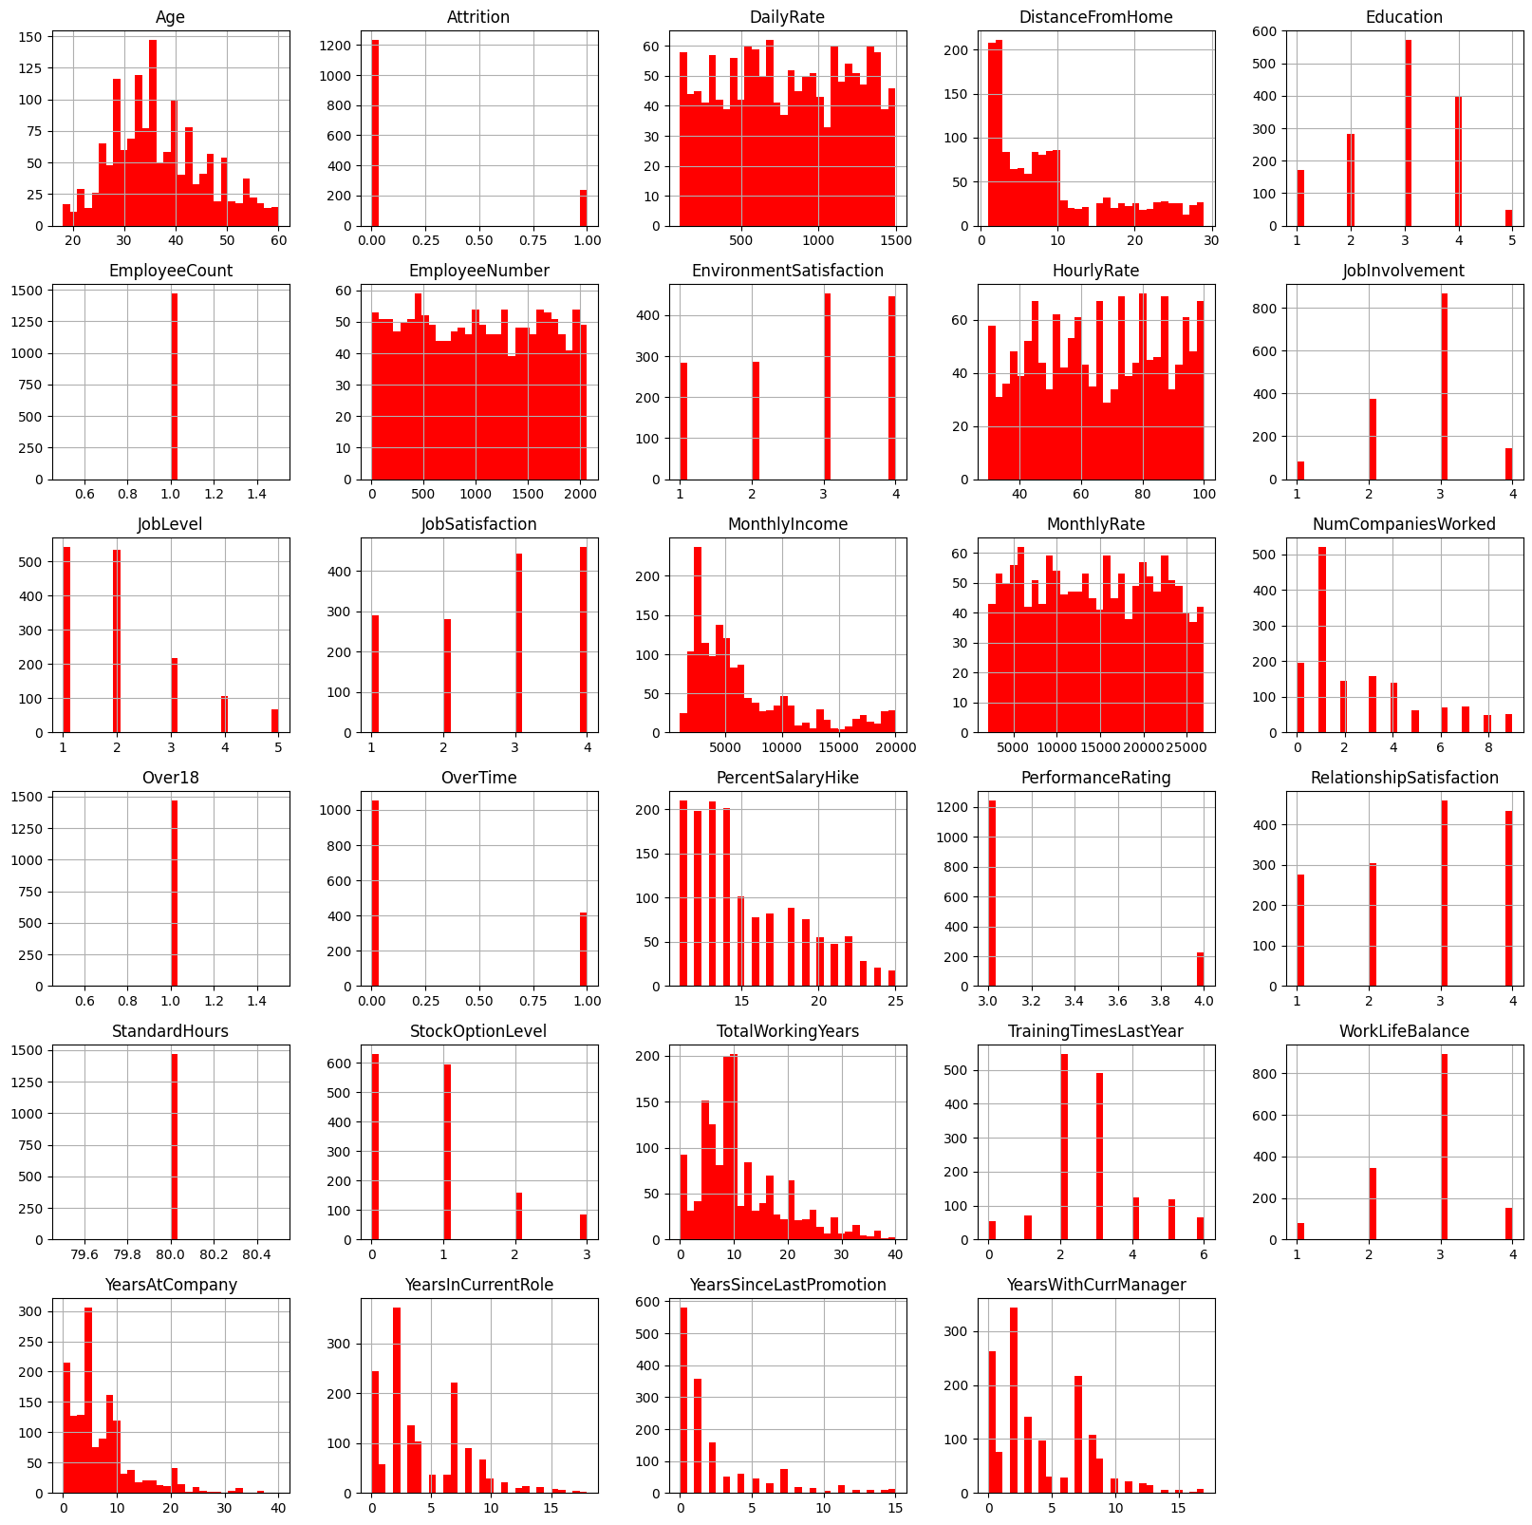
Data visualization of various attributes taken

Slide 29
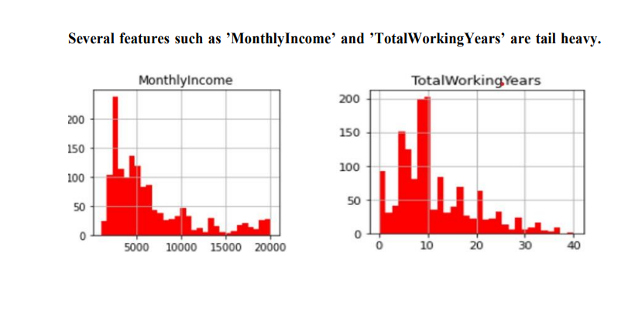

Slide 30
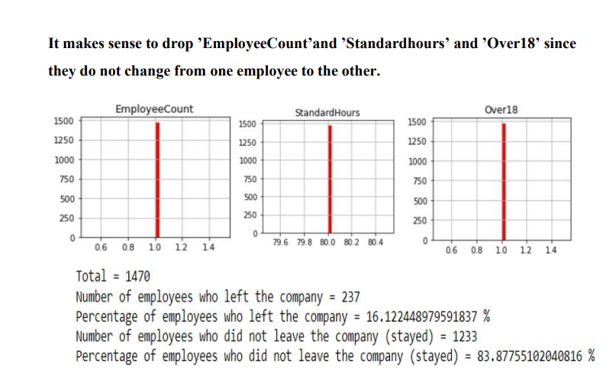

Slide 31
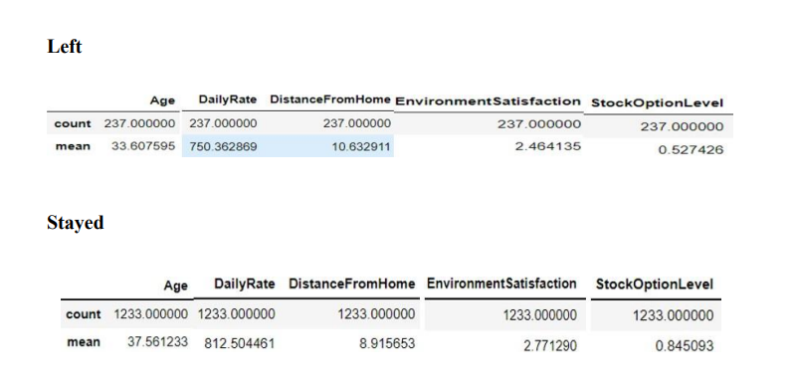
Let’s compare the mean and std of the employees who stayed and left
’age’: mean age of the employees who stayed is higher compared to who left
’DailyRate’: Rate of employees who stayed is higher ’DistanceFromHome’: Employees who stayed live closer to home
’EnvironmentSatisfaction’: Employees who stayed are more satisifed with their jobs
’StockOptionLevel’: Employees who stayed tend to have higher stock option level

Slide 32
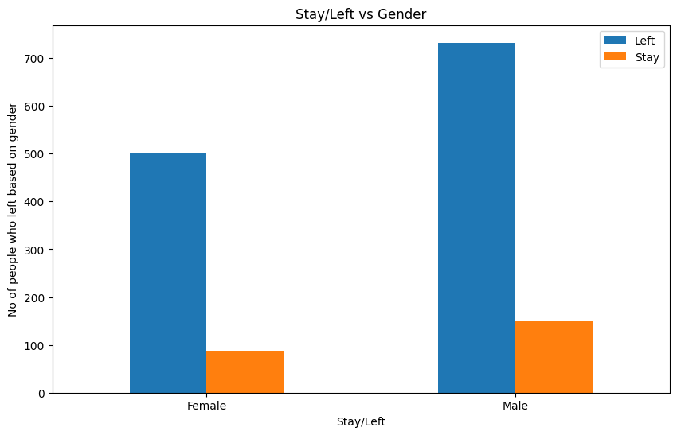
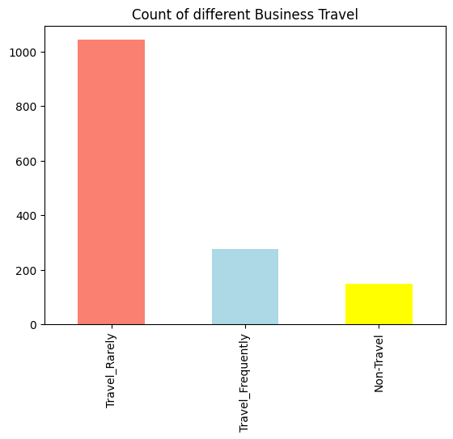
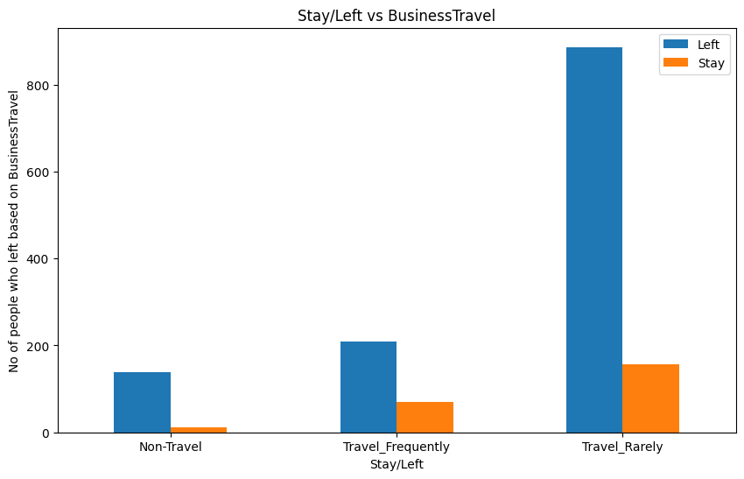
IMPLEMENTATION:

Slide 33
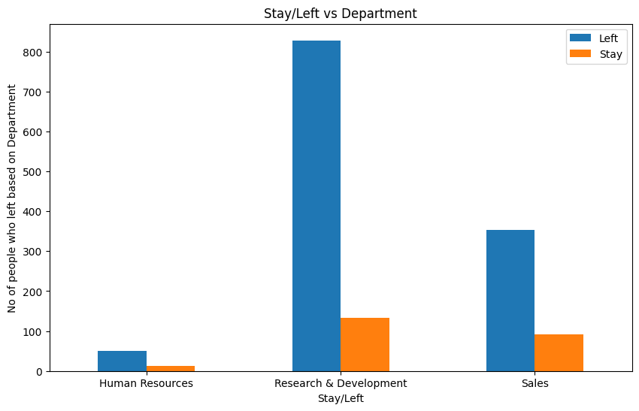
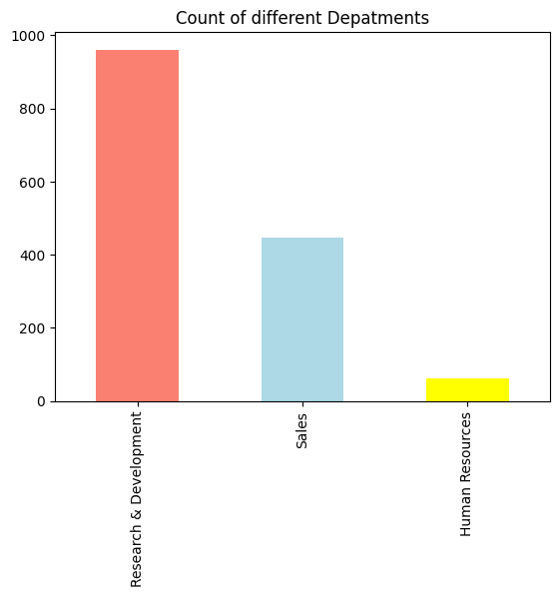

Slide 34
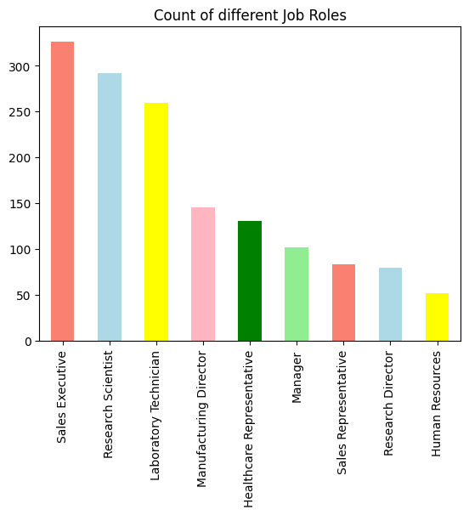
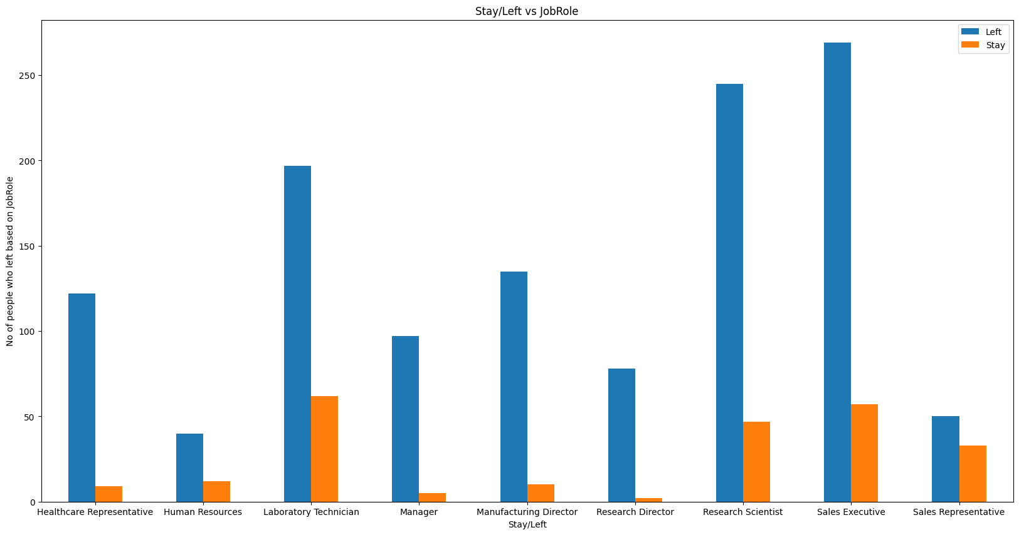

Slide 35
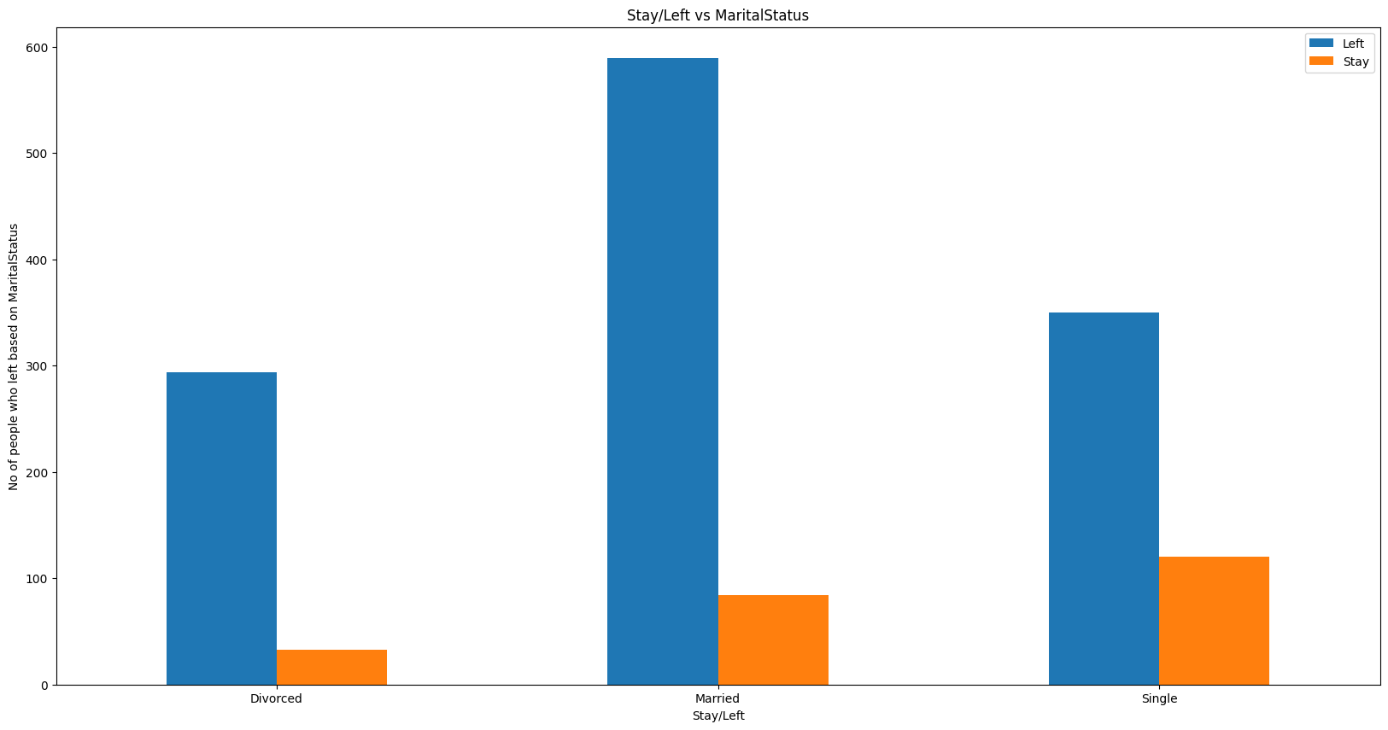
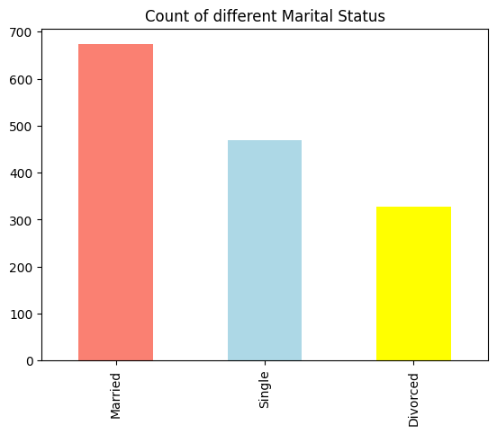

Slide 36
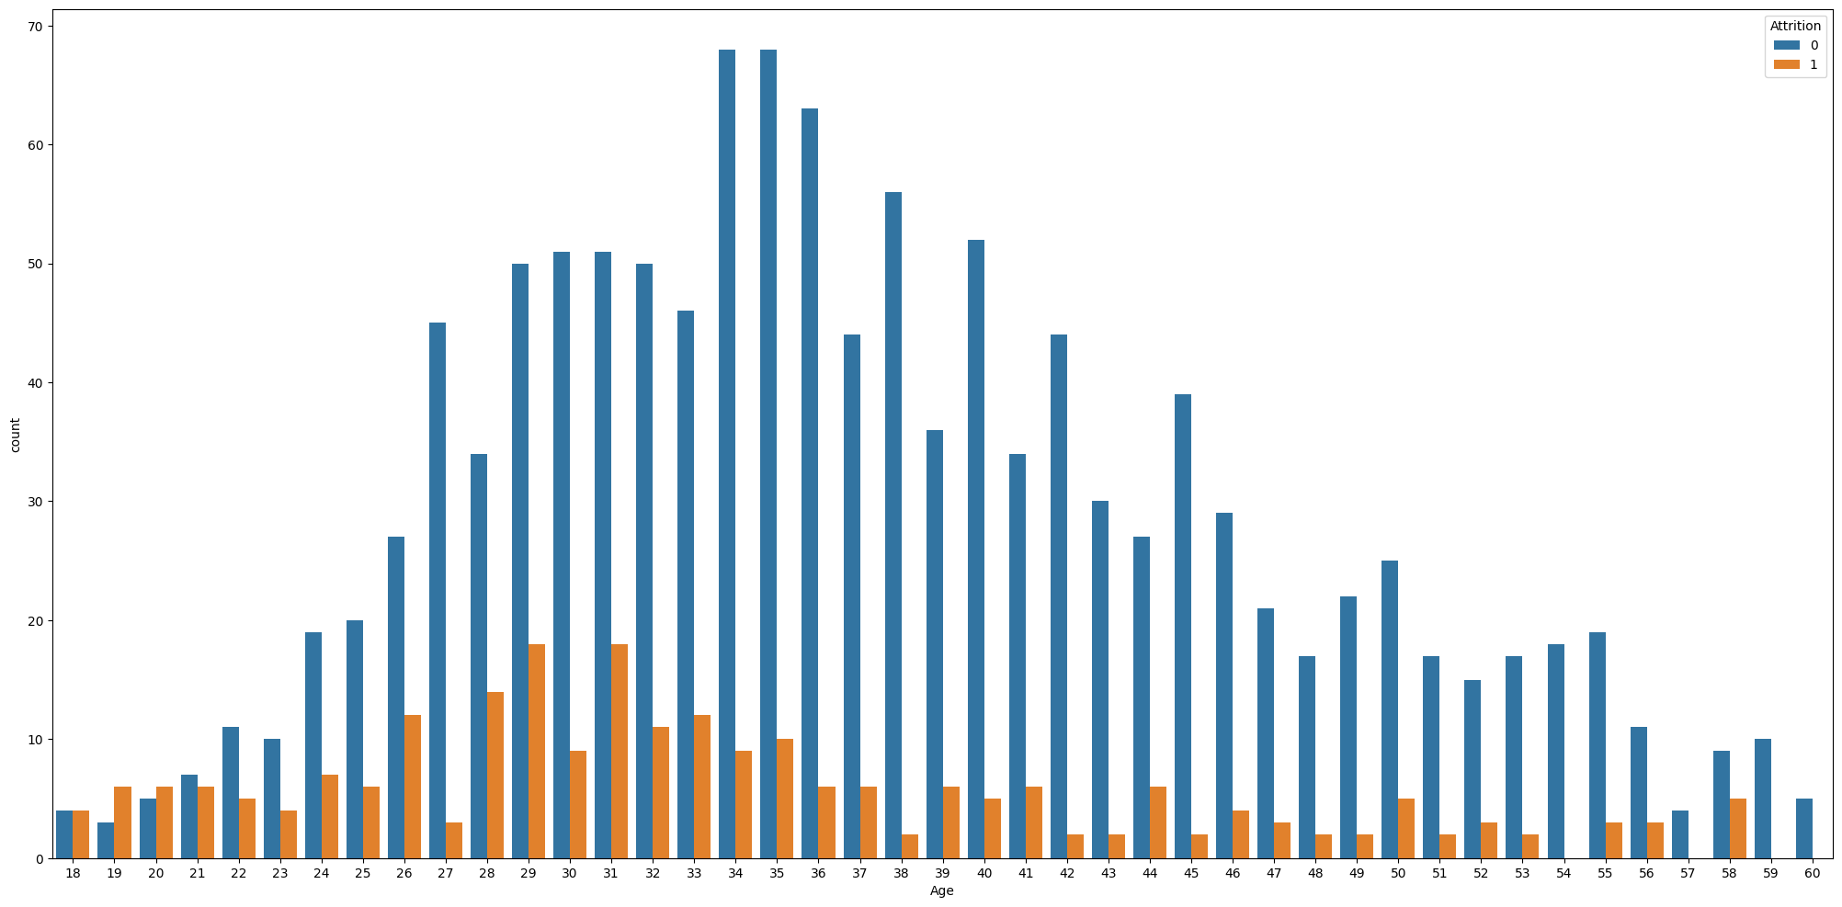

Slide 37
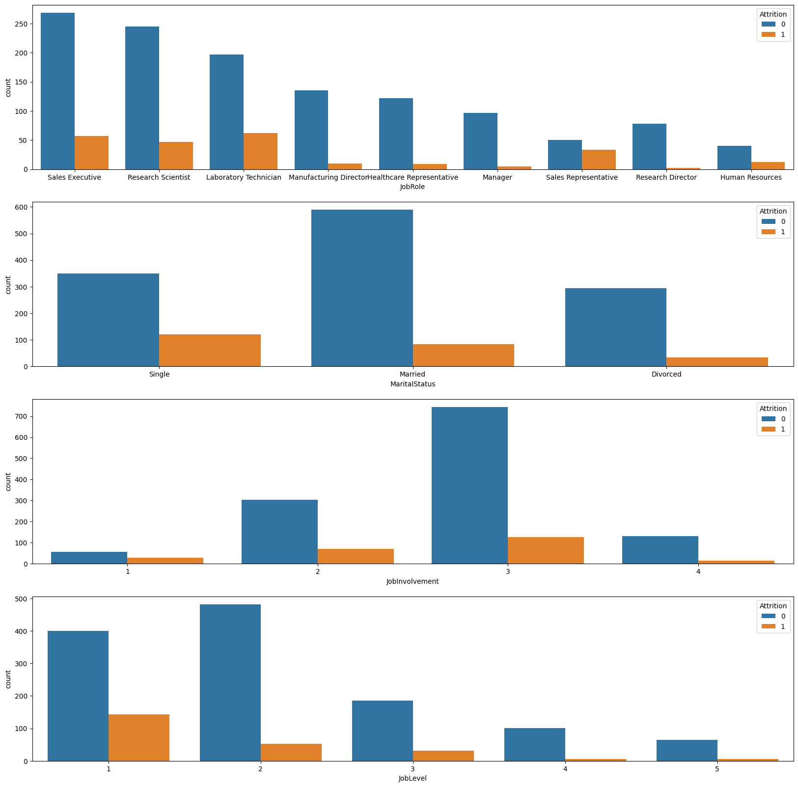

Slide 38
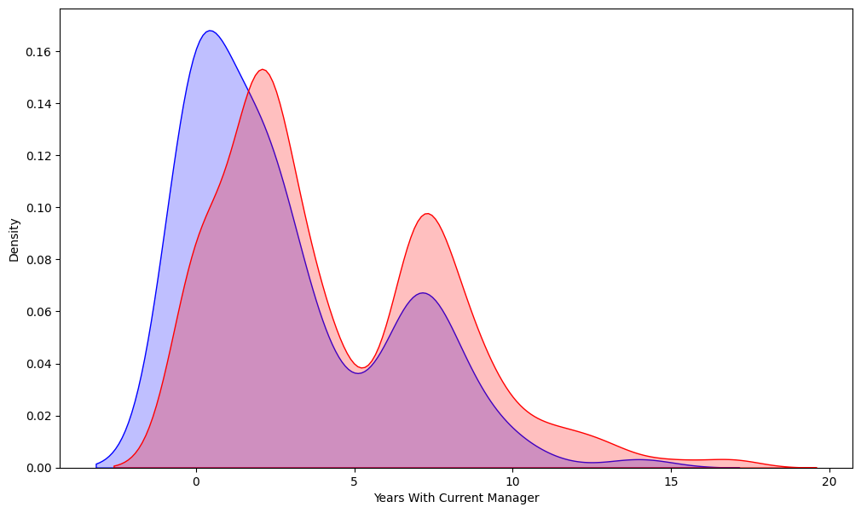
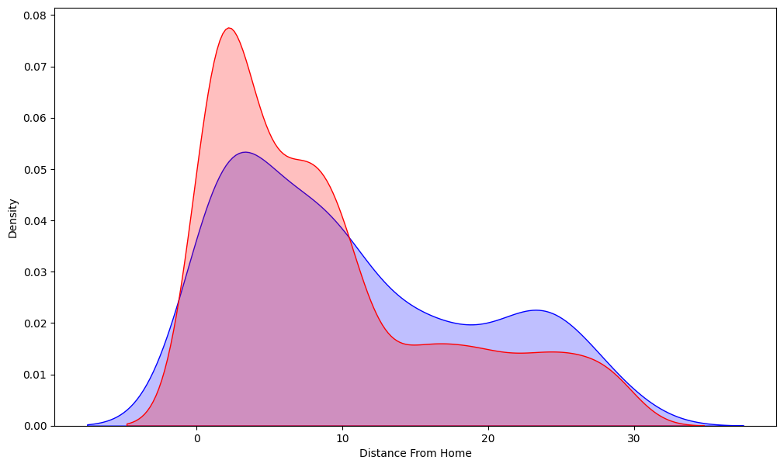
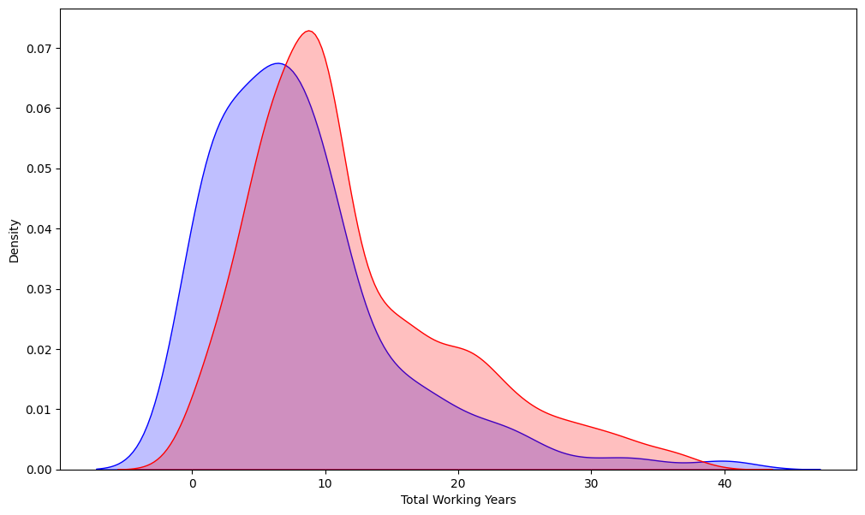

Slide 39
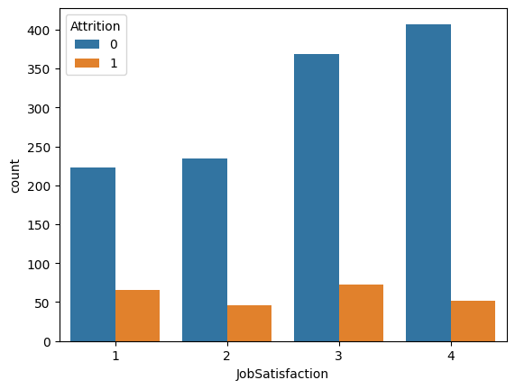

Slide 40
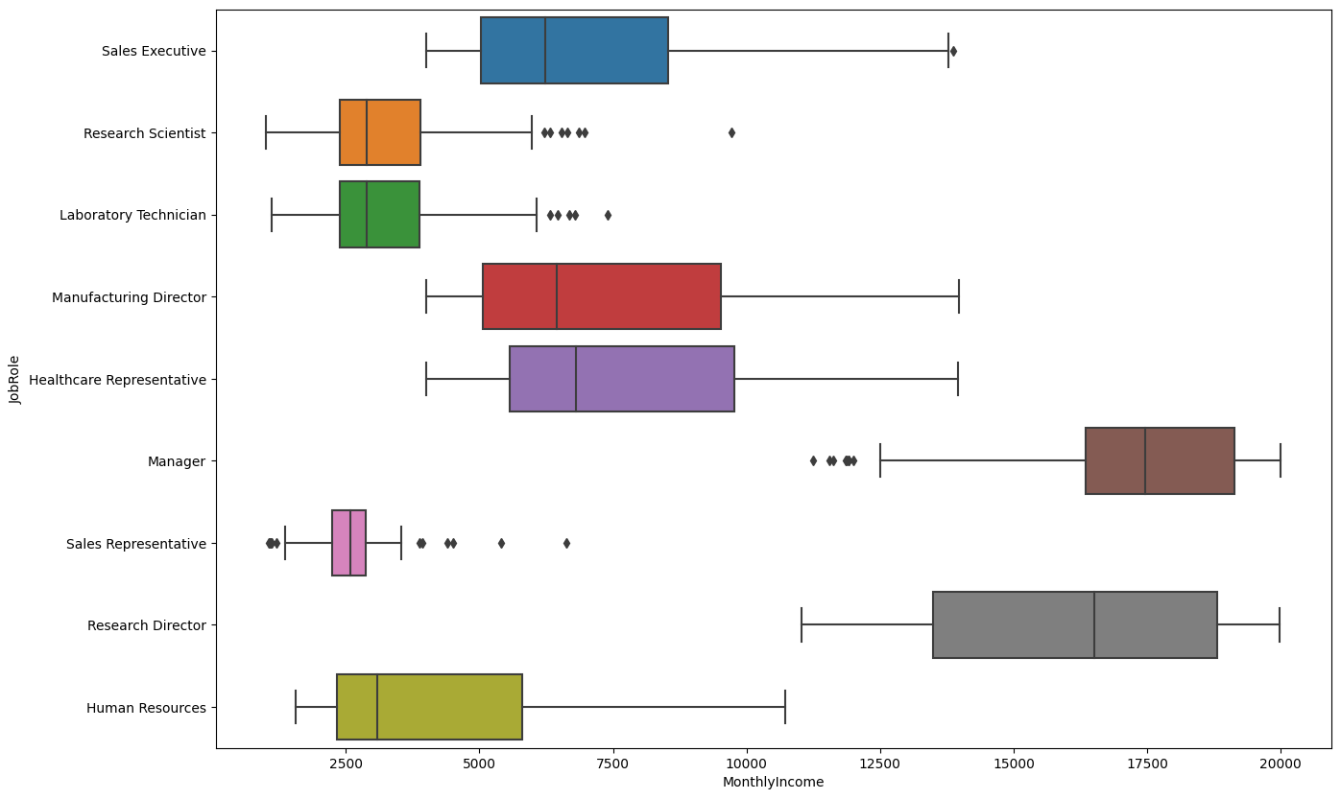

Slide 41
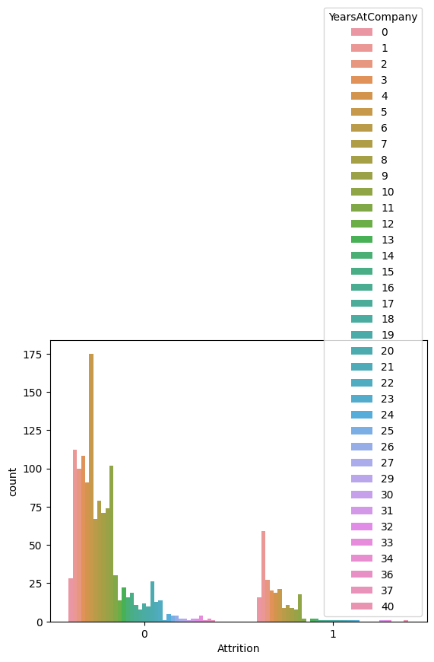
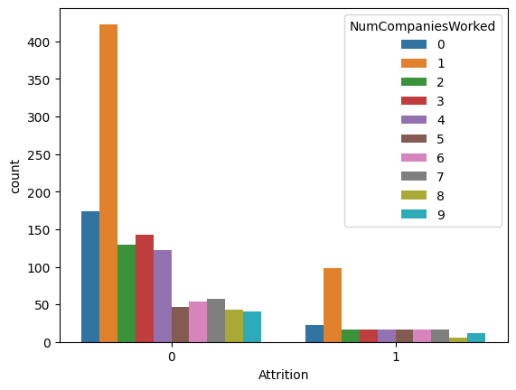
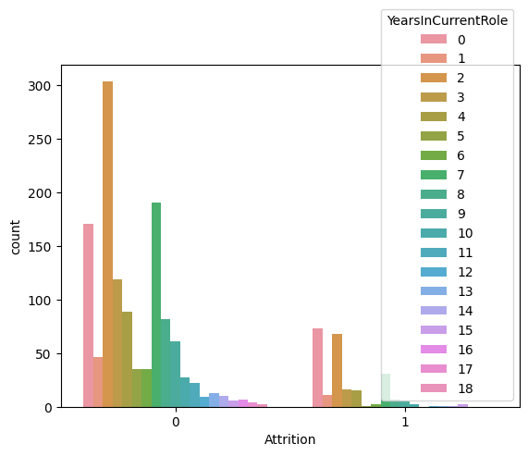

Slide 42
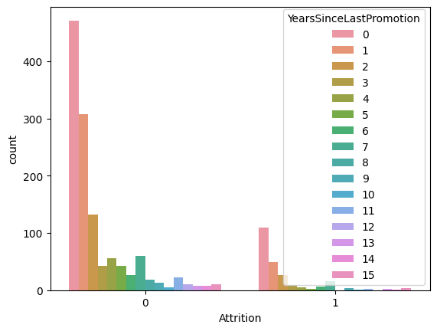
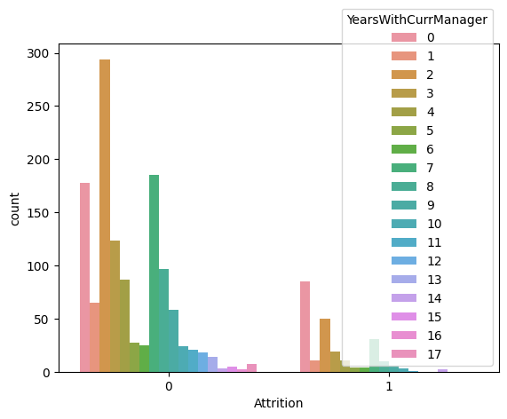

Slide 43
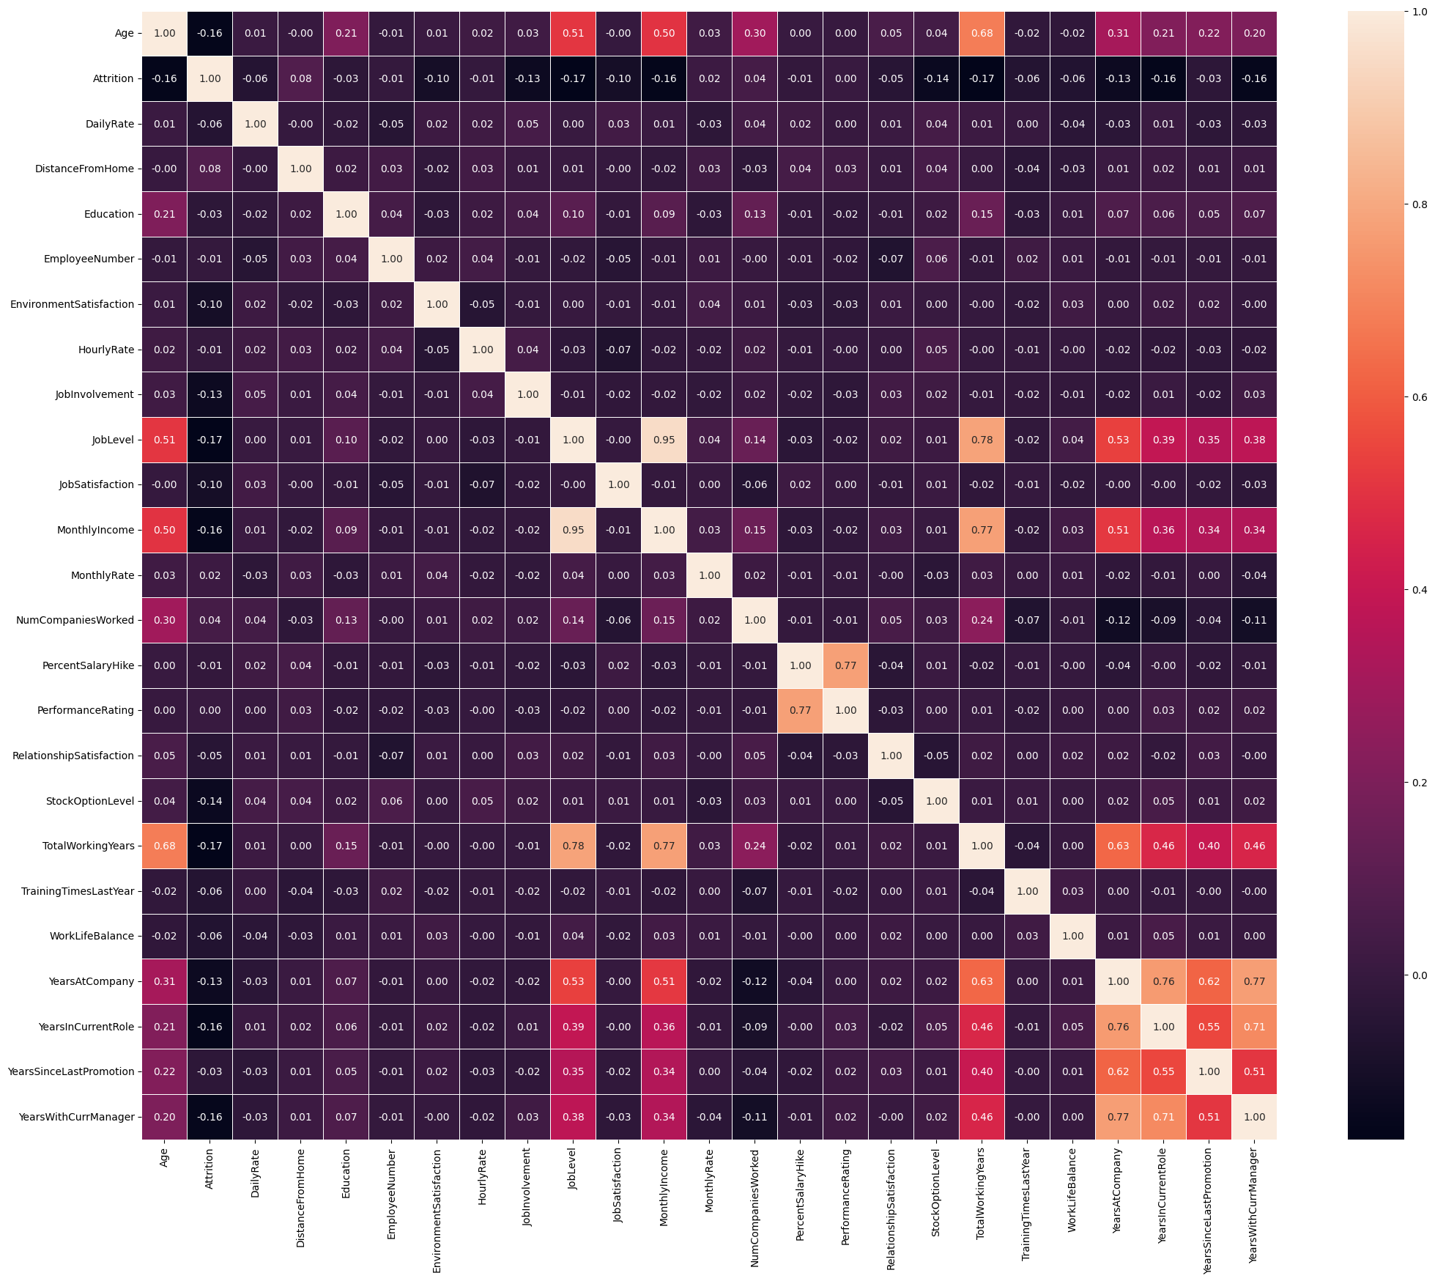

Slide 44
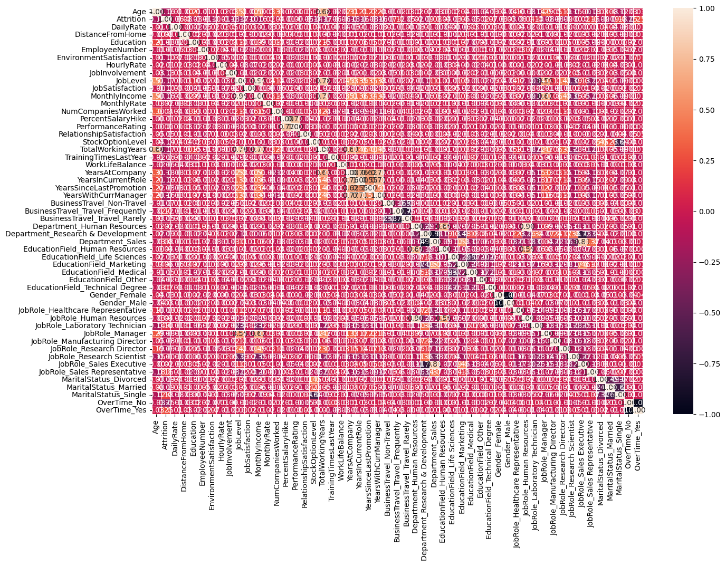

Slide 45
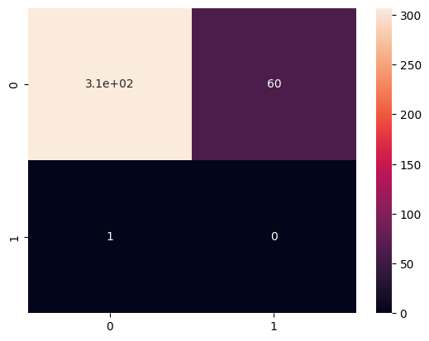


Slide 47
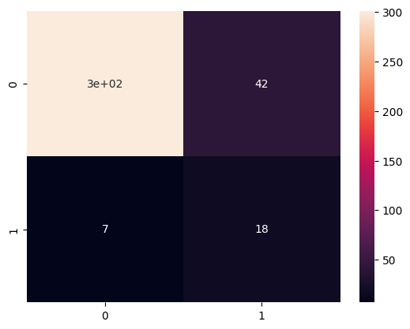
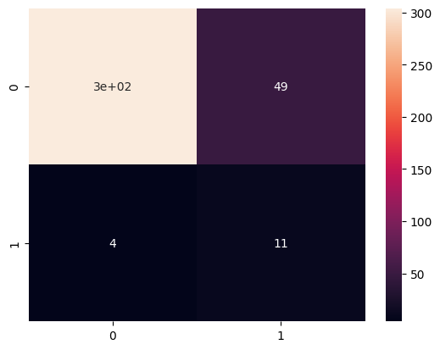
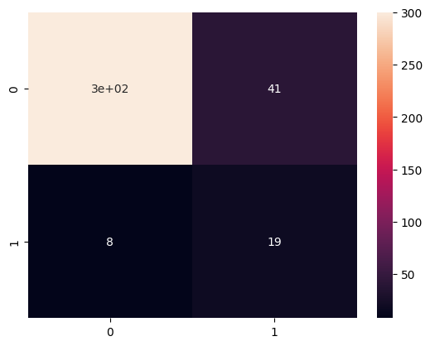

Slide 48
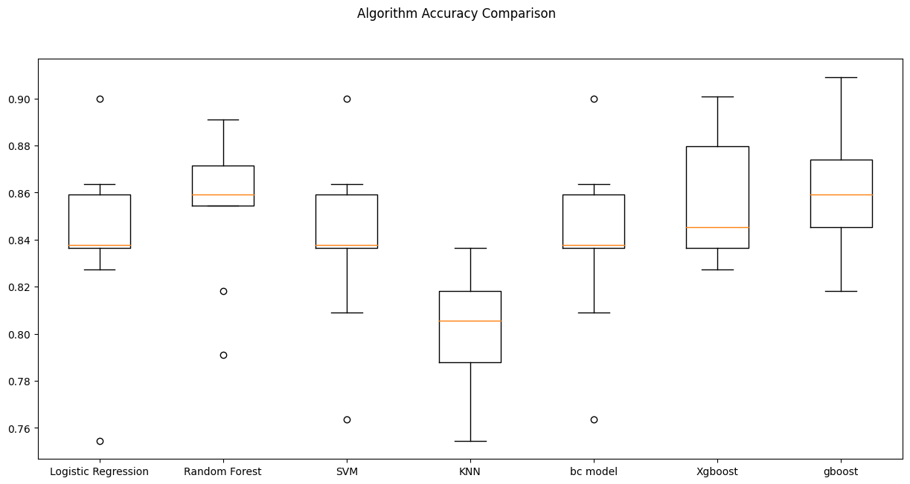

Slide 49
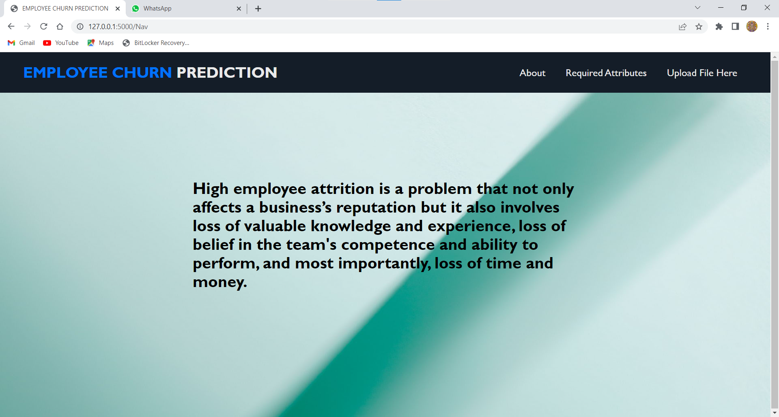

Slide 50
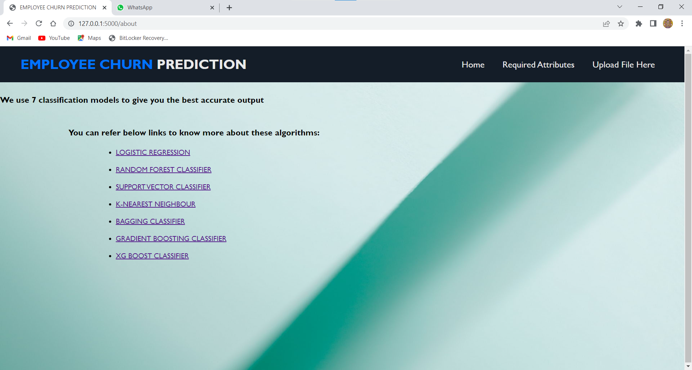

Slide 51
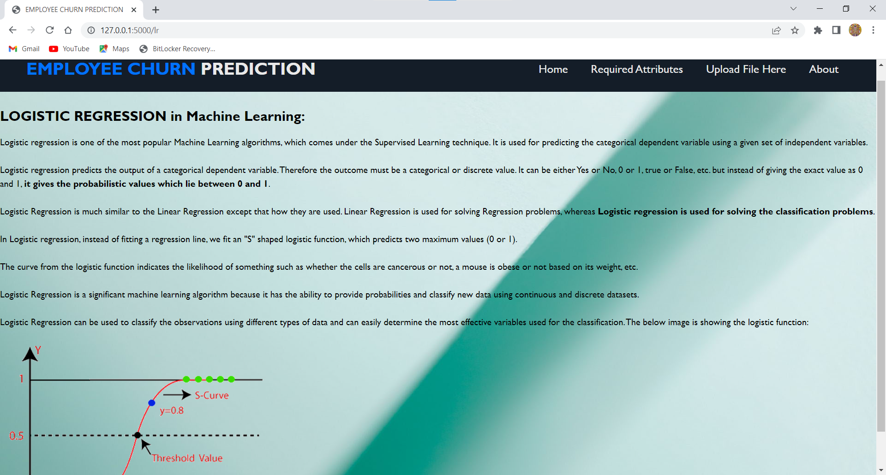

Slide 52
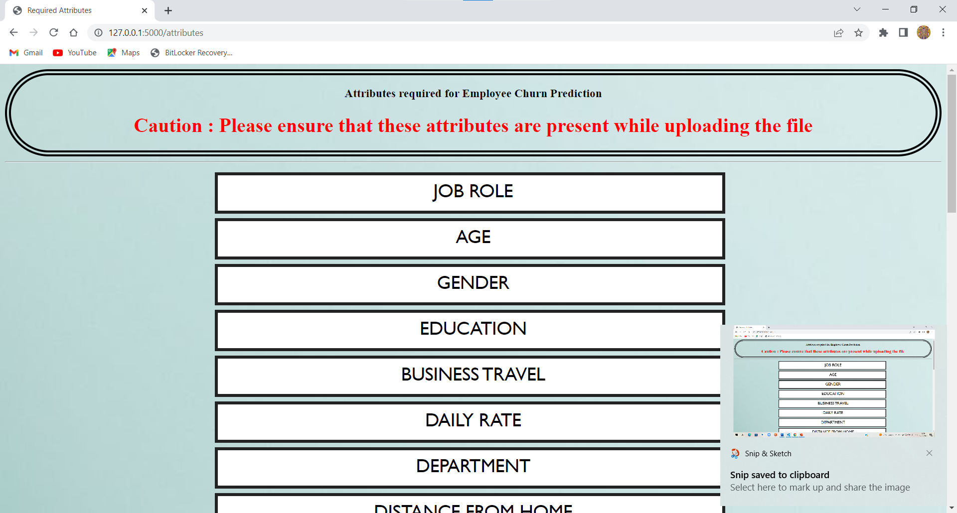

Slide 53
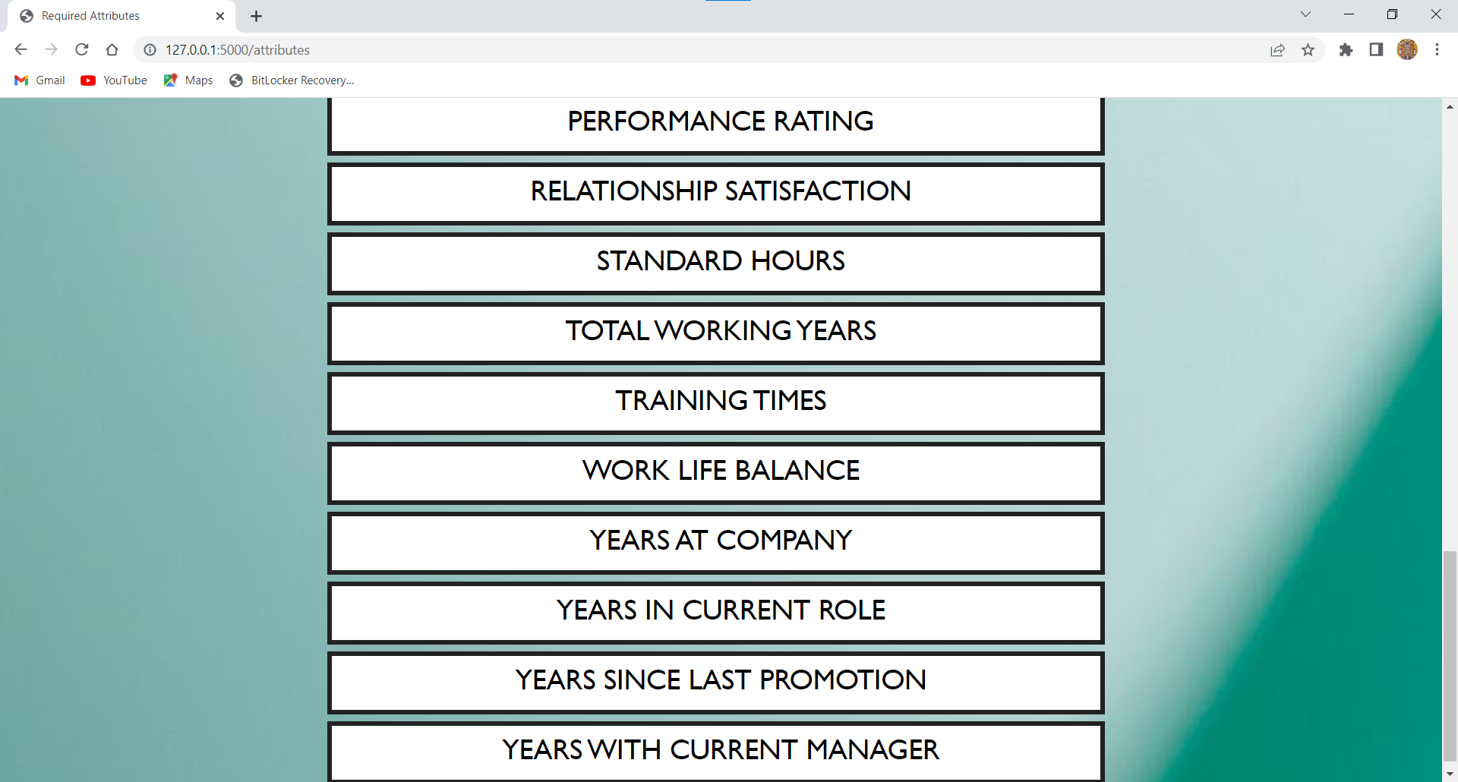

Slide 54
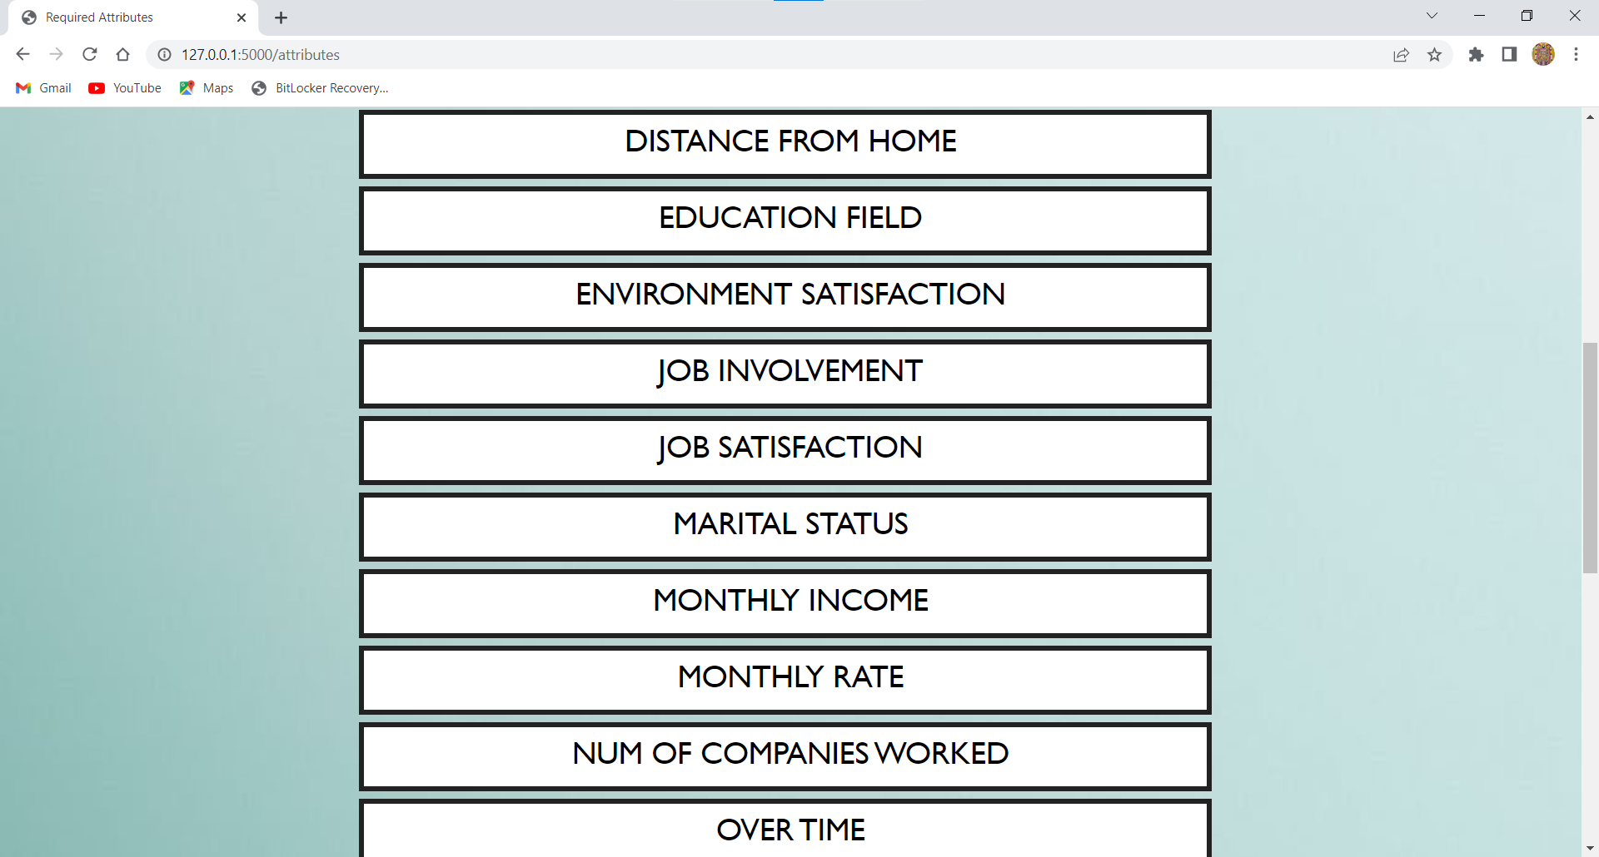

Slide 55
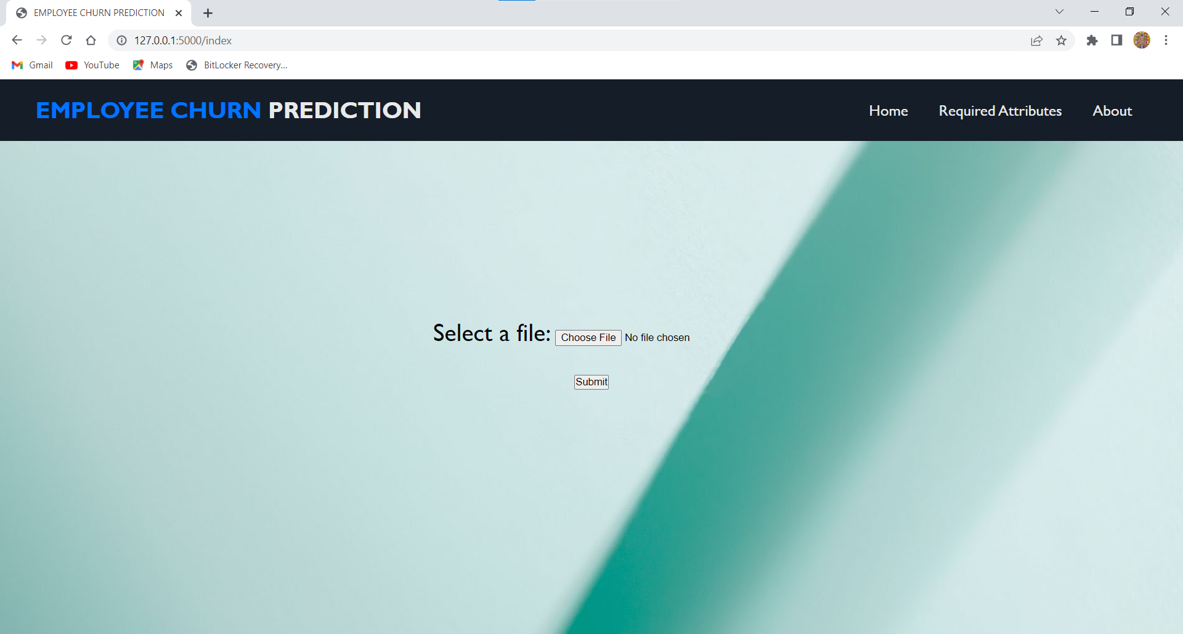

Slide 56
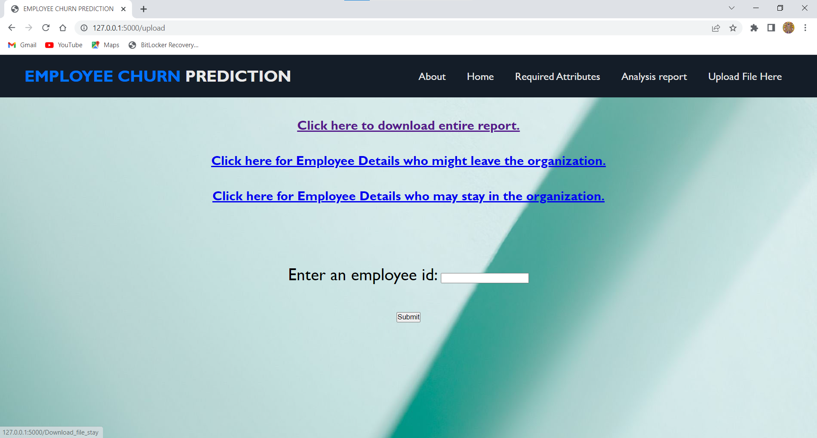

Slide 57
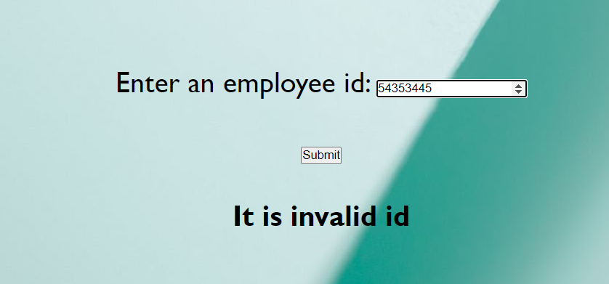

Slide 58


Slide 59


Slide 60
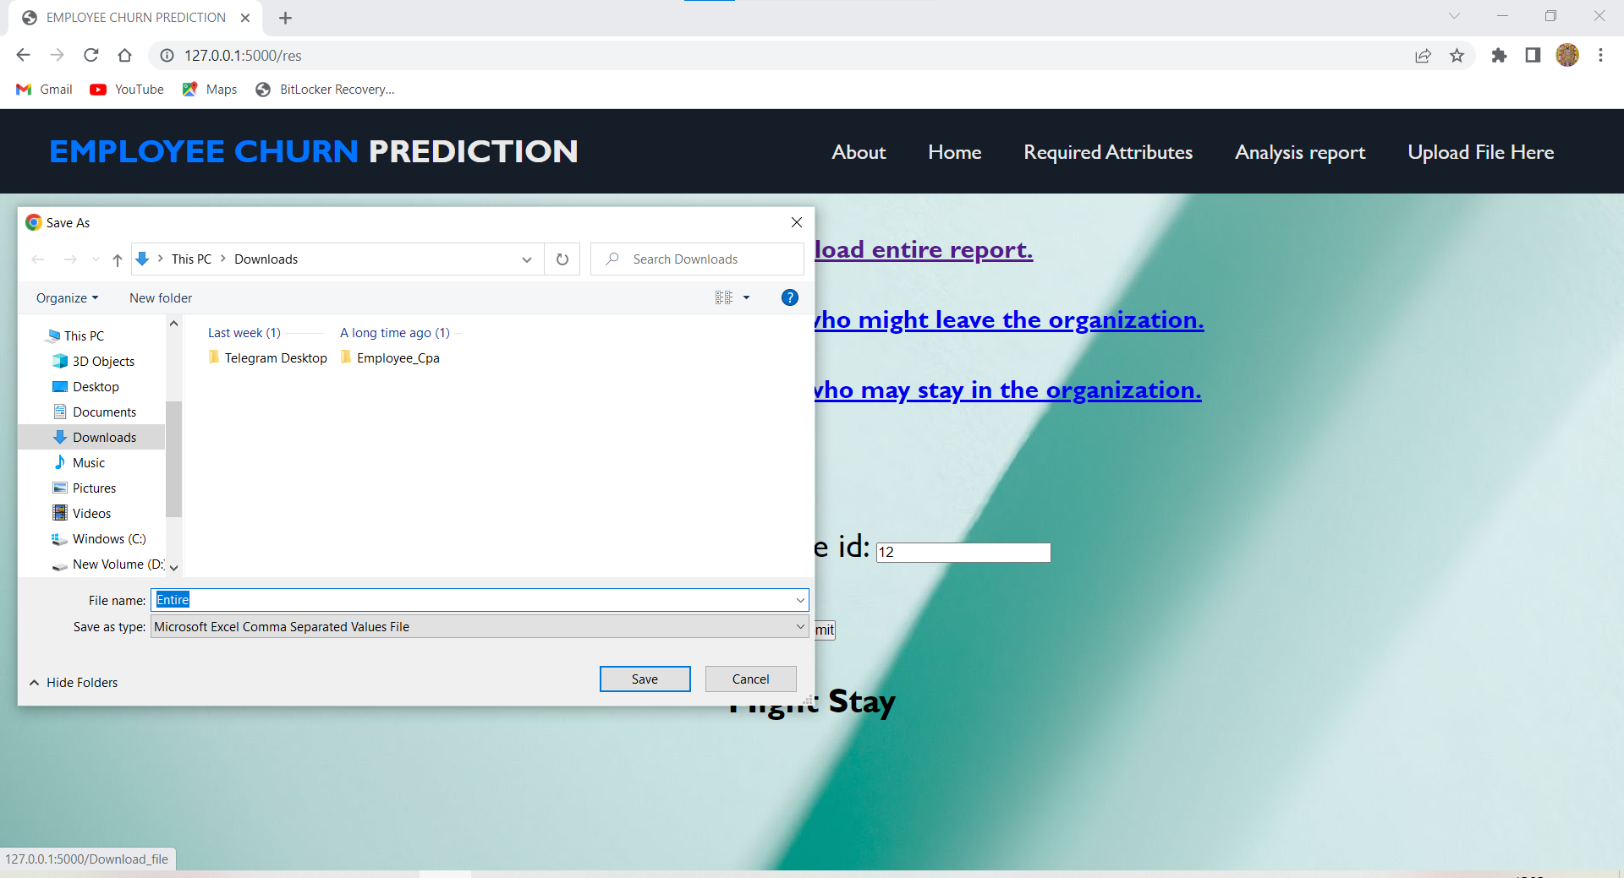

Slide 61


